Slide 1

DE-Project „Multi-Robot Path Planning“
Presentation of Results
Moving Forward with Tradition
Nele Traichel
24.05.2020

Slide 2
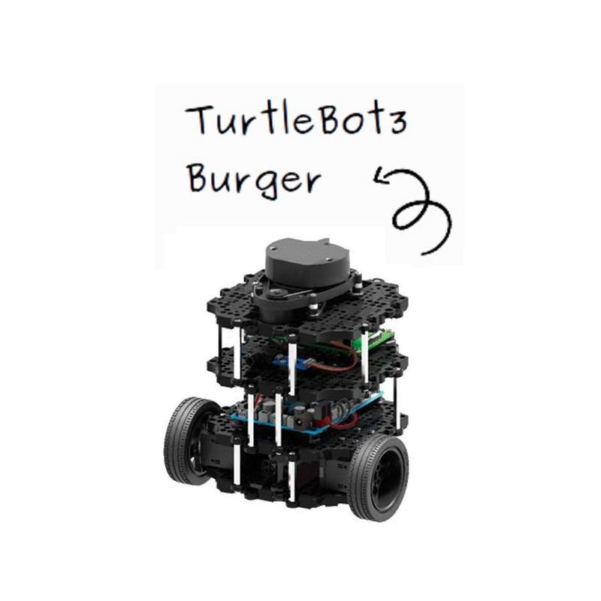
Outline
Objective
Main Idea
Steps Taken
Benchmark Results
Outlook
* https://www.robot-advance.com/userfiles/www.robot-advance.com/images/robot-educatif-turtlebot3-birger.jpg

Slide 3
1. Objective
Implementing an algorithm that allows multi-robot path planning
Setting:
- ROS
- Turtlebot3
- Gazebo Simulation
Challenges:
- Collisions with static obstacles, and other robots
- Fast conflict solving
- Smooth movements
- + Kinematic constraints

Slide 4
Main Idea
Velocity Obstacles
Allow to add constraints
Migration of existing ROS package „multi-robot-collision-avoidance“ (collvoid)
Improvements on top of it

Slide 5
Steps Taken
(see wiki…)

Slide 6
Benchmark Results: Collvoid Local Planner

Slide 7
Benchmark Results: DWA Local Planner

Slide 8
Outlook

Slide 9
Moving forward with tradition
See you in my talk about my master thesis …

